Slide 1
HEARING EXAMINER MEETING PROJECT NOs: 4193 Northwest Avenue Townhomes Preliminary Cluster Subdivision and Subdivision Variance (SUB2023-0031) APPLICANT: Ali Taysi, AVT Consulting, 1708 F Street, Bellingham WA 98225 PROPERTY OWNER: Victor and Galina Shintar, 4193 Northwest AVE Bellingham WA 98226 July 10, 2024

Slide 2
I-III. Proposal and Overview
Application Review Procedures:
As allowed per BMC 21.10.050, the applicant did not consolidate the review of their Type I, II, and III applications. A Consolidated Permit (DR2023-0018 and CAP2023-0026), was issued on 6/26/24 granting approval for design review of the infill townhouses pursuant to Chapters 20.25 and 20.28 BMC and critical areas pursuant to Chapter 16.55 BMC.
Proposed 20 lot infill toolkit preliminary cluster subdivision on an approximately sized 2.24-acre property. The existing single-family residence (SFR) is proposed to be retained and a total of 19 infill townhomes are proposed to be developed in accordance with BMC 20.28.140 on the other 19 lots.
Due to the presence of a wetland bisecting the subject property, the proposed subdivision is configured as two separate east/west development areas fronting Arctic/Mahogany AVEs and Northwest AVE respectively.
A shared access lane with the southern neighbor (4185 Northwest AVE) is proposed off Northwest AVE and the existing driveway will be decommissioned. A Public Works administrative variance has been approved per BMC 13.52.120 for secondary access off Mahogany AVE for the western development area. A privately constructed and maintained trail with a public access easement is proposed through the west development area connecting Mahogany AVE to the southern property at 4197 Dover ST. Pursuant to BMC 23.48.040, the applicant is requesting a subdivision variance from improving the abutting Division RD per the terms of Title 13 (BMC).
Jurisdiction:
The Hearing Examiner is granted authority to hold hearings and make decisions on preliminary plats and variances to the Land Division Ordinance pursuant to BMC 2.56.050(A).

Slide 3
Existing Conditions Site Survey (Attachment A) and CityIQ Aerial

Slide 4
Preliminary Plat
Attachment A

Slide 5
Overall Site Plan
Attachment A

Slide 6
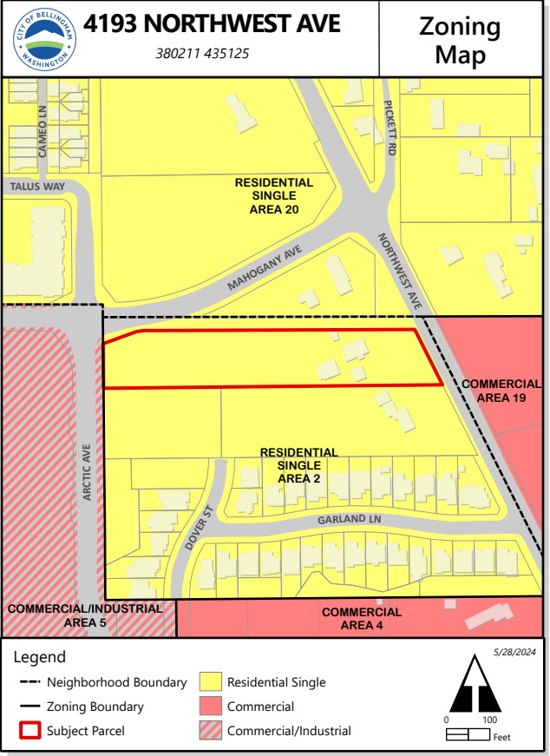
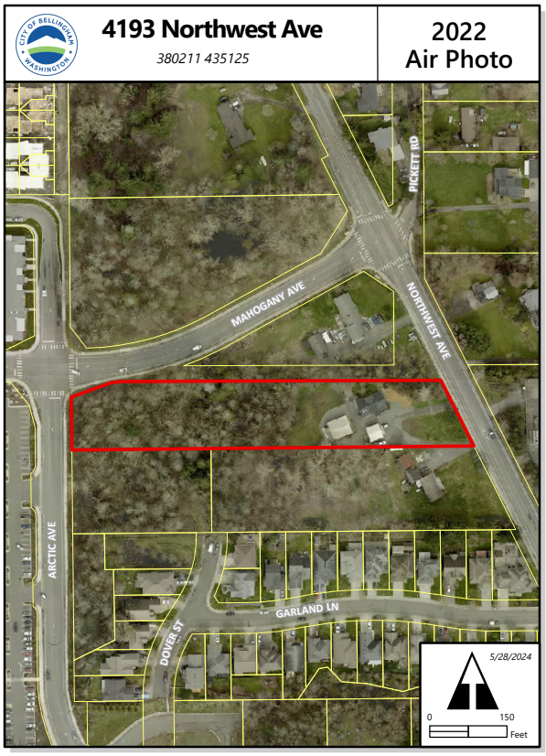

Slide 7
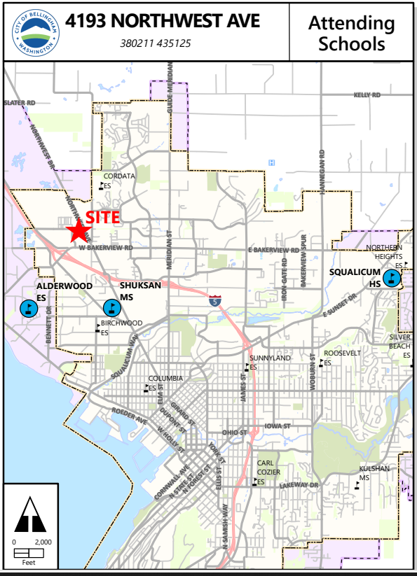
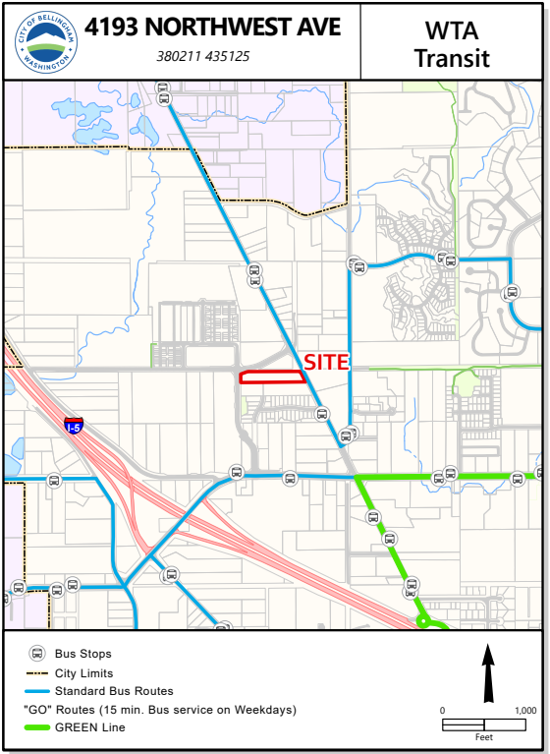

Slide 8
Existing Conditions
The subject site is 2.24 acres and is developed with a single-family residence and two detached accessory buildings. The property contains wetlands and associated buffers which are regulated critical areas.
Properties immediately south are in the same subarea. Preliminary plat approval has been granted (HE-23-PL-022) for 4185 Northwest AVE for nine (9) shared court infill toolkit units and ten (10) infill toolkit townhomes. Land use application(s) have not been submitted for the southern undeveloped property at 4179 Dover Street. Properties north of the subject site are developed with single family residential uses, are in Area 20 of the Cordata Neighborhood, and zoned residential single detached, cluster, cluster attached, and cluster detached and mixed limited duplex and multifamily. Property to the east across Northwest Ave is developed with an electric substation, is in Area 19 of the Cordata Neighborhood, and zoned Commercial, Planned. Property to the west across Aldrich Road is developed with Costco, is in Area 5 of the Meridian Neighborhood, and zoned Industrial/Commercial Planned, mixed.
The site abuts Northwest Ave, Arctic Ave, and Mahogany Ave. All streets are arterials constructed to full city standard. A 10’ ROW dedication is needed along Northwest Ave.
The nearest bus stops are approximately 525 feet south (Stop ID 2255) and approximately 1,200 feet to the north (Stop ID 3259) with hourly service for route 27 to Cordata and Whatcom Community College.
Water, sewer, and stormwater mains are in all abutting streets.
Zoning:
Area 2 of the Meridian Neighborhood zoned Residential Single with a Planned Mixed-use qualifier with Infill Toolkit uses as an allowed use. The land use designation is Residential Single, Low to Medium Density. The base density for the zoning is 3,600 square feet (sf) per unit when developed with infill housing pursuant to BMC 20.28.050(B) and BMC 20.00.100. Single family detached cluster lots require a minimum lot size of 4,000 sf pursuant to BMC 23.08.050(A)(3). The maximum allowed density for the subject property is 27 units.

Slide 9
IV. Background
On 11/23/2021, the applicant completed a pre-application conference with City staff (PRE2021-0112).
On 3/31/2022, the applicant held a virtual pre-application neighborhood meeting (PRE2022-0029). The land use consultant and City project planner were in attendance and no members of the public attended the meeting.
On 6/27/2023, the City issued a Multimodal Transportation Concurrency Certificate (CON2023-0008).
On 6/29/2023, the applicant submitted applications for Preliminary Cluster Subdivision, Subdivision Variance from street improvements (SUB2023-0031), Design Review (DR2023-0018), Critical Areas (CAP2023-0026), and a SEPA checklist (SEP2023-0024) (Attachment A and E).
On 7/27/2023, city staff issued a Notice of Complete in accordance with Title 21 (BMC).
On 7/27/2023, city staff also issued a Request for Information Letter (Attachment F).
On 12/19/2023, the applicant submitted revised materials in response to the 7/27/23 RFI (Attachment G).
On 1/19/2024, city staff issued a Notice of Application and Optional Determination of Non-Significance and mailed notice was provided in accordance with Title 21 (BMC).
One request for information was received during the public comment period (Attachment H). The commentor requested a PDF copy of the plans set to review. Staff provided the document and the commentor had no further questions or opinions. All correspondence was forwarded to the applicant.
On 2/2/2024, city staff issued a Request for Information Letter (Attachment F).
On 3/19/2024, the applicant submitted revised materials in response to the 2/2/24 RFI.
On 4/22/2024, the applicant and city staff held a meeting to discuss minor code compliance items and design options.
On 4/23/2024, a SEPA threshold determination of non-significance was issued for SEP2023-0024 (Attachment I).
On 4/24/2024, the applicant submitted updated plans in response to the 4/22/24 meeting.
On 5/31/24, the applicant submitted a narrative, a revised site plan, and a revised critical area report denoting changes to the stormwater plan for the eastern portion of the development. Staff reviewed the proposed changes and determined them consistent with previous analysis and the DNS.
On 6/25/24, the City issued a Notice of Hybrid Public Hearing.
On 6/25/24, a Consolidated Design Review and Critical Area Permit (DR2023-0018 and CAP2023-0026) was approved with conditions contingent upon Hearing Examiner approval of the Preliminary Cluster Plat and Subdivision Variance from street improvements. The appeal period closes on 7/10/24. As of the writing of this staff report, an appeal has not been received by the City.
On 7/10/24, the Hearing Examiner is scheduled to hold a public hearing to consider the Preliminary Cluster Plat and Subdivision Variance from street improvements.

Slide 10
Public Comment
One request for information was received during the public comment period (Attachment H). The commentor requested a PDF copy of the plans set to review. Staff provided the document and the commentor had no further questions or opinions. All correspondence was forwarded to the applicant.
After the publishing of the staff report, a public comment was received with questions about the consolidated permit and the upcoming hearing (Attachment P). Staff explained the City approved the design review and critical area permit portions of the project, and the public hearing is for the preliminary cluster subdivision and subdivision variance. All correspondence was forwarded to the applicant.

Slide 11
VIII. Cluster Preliminary Plat Criteria BMC 23.16.030 1. It is consistent with the applicable provisions of this title, the Bellingham comprehensive plan and the Bellingham Municipal Code; 2. It is consistent with the applicable provisions of Chapter 23.08 BMC; 3. The division of land provides for coordinated development with adjoining properties or future development of adjoining properties through, where appropriate, the extension of public infrastructure, shared vehicular and pedestrian access, and abutment of utilities; 4. Each lot in the proposal can reasonably be developed in conformance with applicable provisions of the BMC, including but not limited to critical areas, setbacks, and parking, without requiring a variance that is not processed concurrently with the subdivision application pursuant to Chapter 23.48 BMC; 5. There are adequate provisions for open spaces, drainage ways, rights-of-way, sidewalks, and other planning features that assure safe walking conditions for pedestrians, including students who walk to and from school, easements, water supplies, sanitary waste, fire protection, power service, parks, playgrounds, and schools; and 6. It will serve the public use and interest and is consistent with the public health, safety, and welfare. The director shall be guided by the policy and standards and may exercise the powers and authority set forth in Chapter 58.17 RCW, as amended. B. Notwithstanding approval criteria set forth in subsection (A) of this section, in accordance with RCW 58.17.120, as amended, a proposed subdivision may be denied because of flood, inundation or presence of environmentally sensitive areas as regulated by Chapter 16.55 BMC. Where any portion of the proposed subdivision lies within both a flood control zone, as established pursuant to Chapter 86.15 RCW, and the area of special flood hazard as defined in Chapter 17.76 BMC, the city shall not approve the preliminary plat unless it imposes a condition requiring the applicant to comply with the applicable regulations in Chapters 16.55 and 17.76 BMC and any written recommendations from the Washington Department of Ecology. In such cases, no development permit associated with the proposed subdivision shall be issued by the city until flood control problems have been resolved. C. An applicant for a preliminary plat may request that certain requirements established or referenced by this title be modified. Such requests shall be processed according to the procedures and criteria for administrative modification or variances in Chapter 23.48 BMC.

Slide 12
IX. Subdivision Variance BMC 23.48.040 1. a. Because of unusual shape, the location of preexisting improvements, other extraordinary situation or condition, or physical limitation including, but not limited to, exceptional topographic conditions, geological problems, or environmental constraints, in connection with a specific piece of property, the literal enforcement of this title would involve difficulties, result in an undesirable land division or preclude a proposal from achieving zoned density; or b. The granting of the variance will establish a better lot design resulting in a development pattern found to be consistent with the neighborhood character including, but not limited to, development orientation to the street, setbacks, lot orientation, or other contextual element associated with the proposed development; and 2. The granting of any variance will not be unduly detrimental to the public welfare nor injurious to the property or improvements in the vicinity and subarea in which the subject property is located.

Slide 13
XI. Conclusion
Based upon staff's analysis of the subdivision application and all supporting materials referenced in this staff report, staff finds the subdivision application compliant with the municipal code if properly conditioned and recommends the Hearing Examiner issue an approval, with conditions.
The Proposal furthers the goals and policies of the Comprehensive Plan by providing an infill development opportunity in an area where existing infrastructure and services can be adequately provided to service the proposal. The Proposal is consistent with the current zoning and applicable regulations, as such preliminary plat approval should be granted. An approval would not excuse the applicant from complying with any other federal, state or local statutes, ordinances or regulations that may be applicable to this project.
Staff recommends the Hearing Examiner approve the preliminary cluster plat and subdivision variance from street improvements to Division Road for the Proposal as described herein and as provided in Attachments A-N subject to the following conditions:

Slide 14
XII. Conditions
GENERAL REQUIREMENTS
The plat shall be developed generally consistent with the lot layout on Attachment A as conditioned.
Modifications to this decision shall be processed in accordance with BMC 23.16.090.
A clearing and grading plan for the property, including rights-of-way, shall be submitted for review and approval by the Planning and Public Works Departments concurrent with review of civil drawings for the infrastructure.
Development of the property shall be consistent with the provisions of BMC Title 23, and with the description of the Proposal contained in the Determination of Non-significance, except as otherwise provided herein.
Impact fees for transportation, schools and parks shall be paid in accordance with applicable BMC requirements.
Preliminary plat approval shall expire as provided in BMC 23.16.070.
All conditions of the Consolidated Permit (Attachment B) shall be deemed conditions of this decision.

Slide 15
XII. Conditions Continued
CONDITIONS FOR FINAL PLAT APPROVAL
The applicant shall obtain all necessary permits and/or approvals from the City necessary to satisfy the following conditions prior to final plat approval pursuant to Chapter 23.16 BMC.
Phasing shall be allowed in accordance with BMC 23.16.010(E). A phasing plan shall be submitted for review and approval by the City concurrently with the public facility construction agreement for the first phase.
Access to the eastern site shall be provided through a shared access easement with the southern abutting property to Northwest Ave and improved to a full lane standard as shown on Attachment A. The existing driveway curb cut off Northwest Ave shall be removed. The applicant shall be required to submit a shared access easement for City review and approval which shall be recorded with the Whatcom County Auditor prior to final plat approval.
Secondary access shall be allowed and provided off Mahogony Avenue as shown on Attachment A.
The applicant shall be required to dedicate 10’ of additional right of way abutting Northwest Ave to the City for potential future public infrastructure improvements prior to final plat approval.
The applicant shall be required construct a pedestrian trail connecting to 4179 Dover Street and dedicate a 10' public access easement overtop as shown in Attachment A. The easement shall indicate it is for public access and privately maintained. Said easement shall be completed prior to the permitting of the west phase of the project.
The applicant shall be required to obtain a Public Facilities Construction Agreement and obtain final approval from the City for the extension of water/sewer/stormwater mains in accordance with Public Works Department requirements prior to final plat approval. The public utility main extensions shall be generally consistent with Attachment A and require public utility easements reviewed and approved by the City and recorded with the Whatcom County Auditor prior to final plat approval. The required public infrastructure construction shall be completed and accepted by the City prior to final plat approval.
The applicant shall decommission the existing septic system on Lot 20 and provide a new sewer service line for the single-family residence from the main extension off Northwest Avenue as shown in Attachment A.
The existing garage on Lot 20 shall be demolished and replaced with a garage providing at least two 9’x18’ parking spaces as proposed in Attachment A or replaced by two 9’x18’ surface parking spaces located outside the front yard setback and surfaced with no less than 3” crushed gravel in accordance with BMC 20.30.
The applicant shall provide evidence to demonstrate compliance with BMC 23.08.070 (E and F).
The applicant shall be required to submit private covenants, conditions and restrictions (CC&Rs) for vehicular/pedestrian access, parking, utilities, open space amenities, waste/recycling, mail service, etc. for City review and approval prior to final plat approval. The private CC&Rs shall be recorded with the Whatcom County Auditor with the recording of the final preliminary plat.
The applicant shall be required to submit common wall agreement(s) for all townhomes in accordance with BMC 20.28.050(F) for City review and approval prior to final plat approval. The common wall agreement(s) shall be recorded with the Whatcom County Auditor with the recording of the final preliminary plat.
Prior to final plat approval, conservation easements required by CAP2023-0026 shall be recorded with the Whatcom County Auditor.
Mailboxes shall be installed as approved by the United States Postal Service.
The applicant shall be responsible for obtaining any and all necessary Federal and/or State approvals associated with the proposal.

Slide 16
XII. Conditions Continued
15. The following shall be shown on the face of the plat, as applicable:
i. Notice of the associated land use approval for Design Review and Critical Area Permitting (DR2023-0018 and CAP2023-0026).
ii. All existing, required, and proposed easements.
iii. A ten-foot-wide easement adjacent to public rights-of-way reserved for utility purposes, as determined necessary by the utility providers.
iv. A note stating that all lots are subject to those conditions set forth in this Order, and as may be amended in accordance with the municipal code.
v. A note referencing any existing private covenants and any covenants specific to the proposed lots.
vi. Stormwater limitations.
16. Stormwater management shall be provided in accordance with Chapter 15.42 BMC and all stormwater facilities shall be dedicated to the city unless determined otherwise by the City Engineer.
17. Street trees shall be installed pursuant to BMC 23.08.080(G)(5) and 23.08.080(C).
18. Pursuant to BMC 16.60.080(A)(1), no clearing is permitted on an undeveloped lot without a valid Building Permit or Public Facility Construction Agreement.
19. The applicant shall be required to take reasonable efforts to preserve existing significant trees on site particularly along the perimeter boundaries of the site and within open space areas not impacted by utilities. Prior to the issuance of a building permit and/or any site disturbance, the applicant shall schedule a site visit with the planning project manager to inspect the clearing limits and tree/critical root zone protection.

